Slide 3
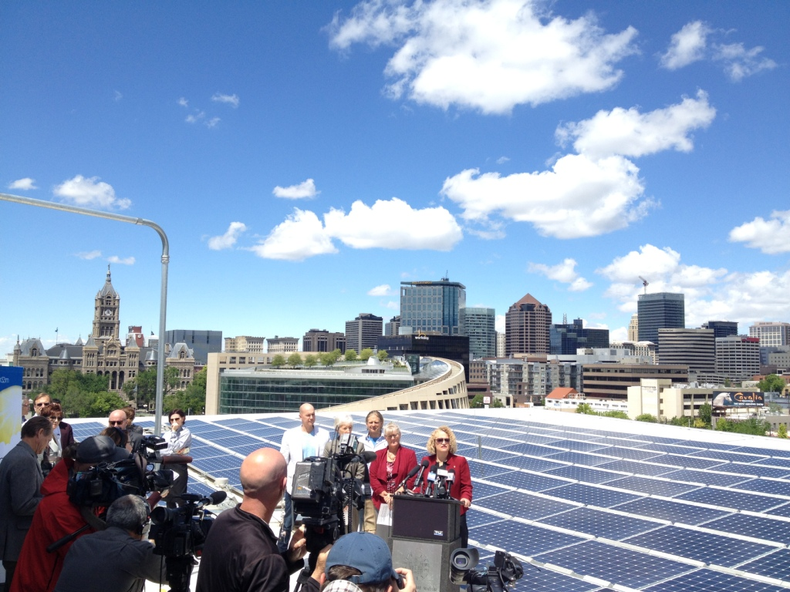

Slide 4
15% Reduced Carbon Footprint by 2015
Decrease Energy Use in City Buildings by 10%
Increase Renewable Energy by 2.5 MW
LEED Gold and Net Zero for New Construction
15% of On-Road Fleet as Clean Vehicles
50% Low-Emissions Employee Commutes

Slide 6
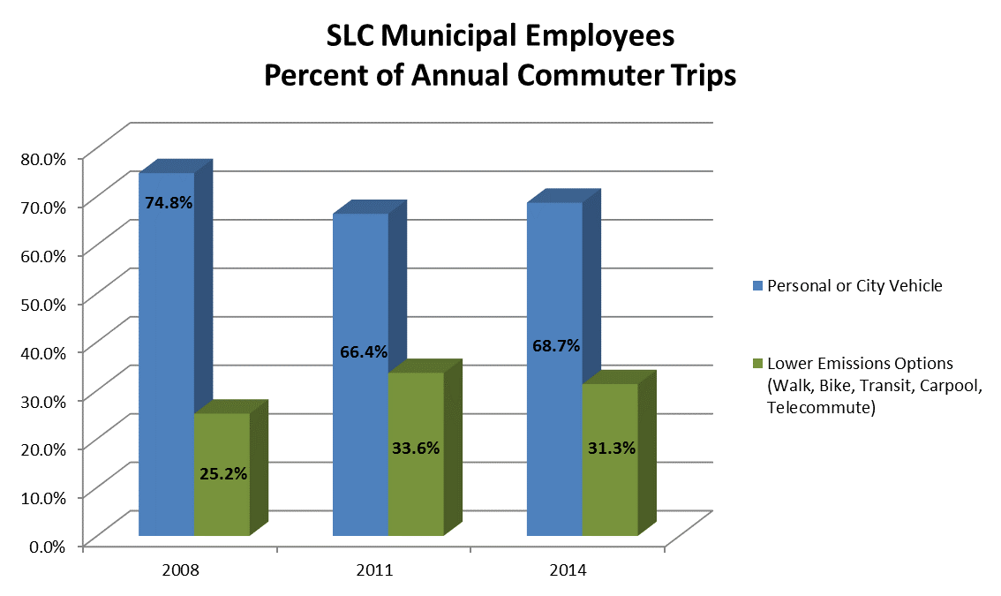

Slide 7
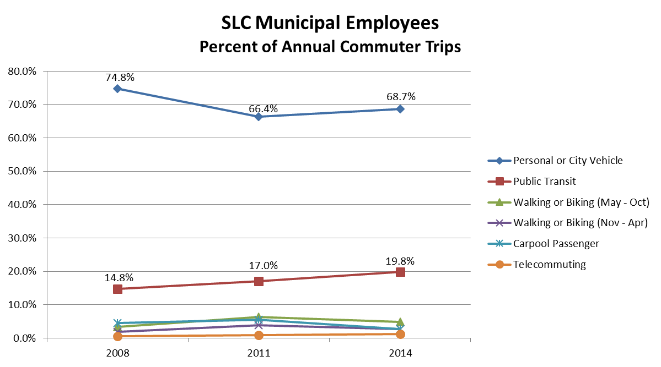

Slide 8
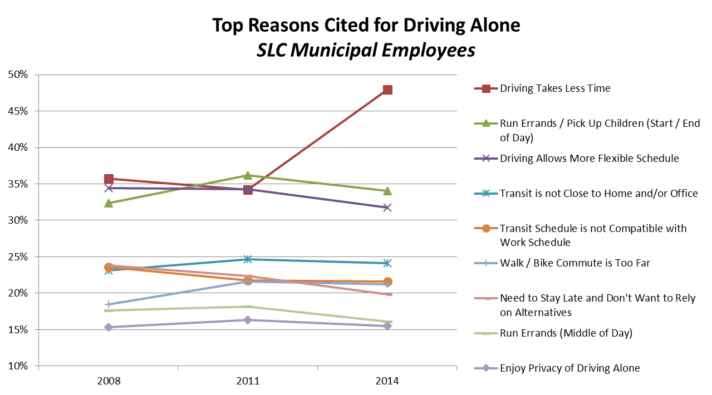

Slide 9
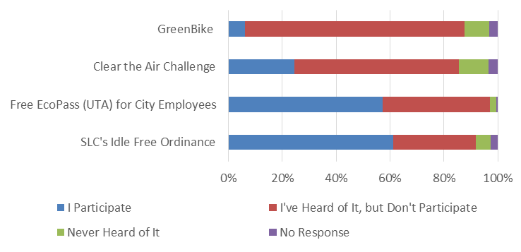

Slide 10
16.2%
20.6%

Slide 11
Budgeting
Procurement Policies & Process
Data Frequency & Accessibility
Employee Engagement

Slide 12
ClearTheAirChallenge.org

Slide 16
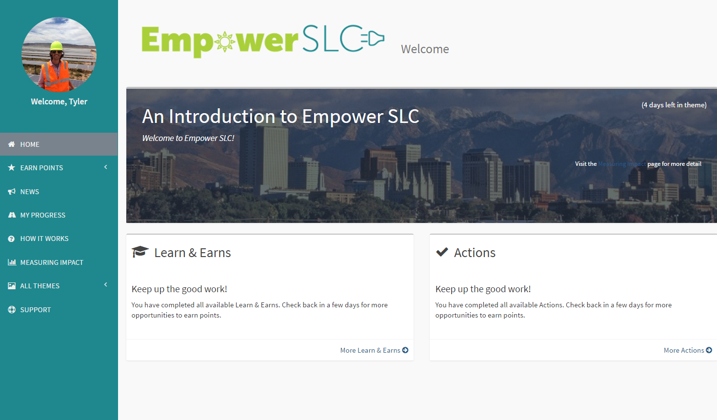

Slide 18
